Slide 1


Problem | Voice of the Patients & Families
Parents/Guardians of Adolescents & Secondary Education Institutions
Invested in their children’s/students’ mental health well-being
Willing to participate in their children(s)’ mental health journey
Understand their child(ren)’s mental health status & needs
When to act, before the condition reaches a crisis level
Where to go to receive care (long-wait times)
How to improve their engagement with their child(ren)
Our Customer
Unmet Need
© Copyright 2023 by Panos Efsta
All Rights Reserved

Slide 2


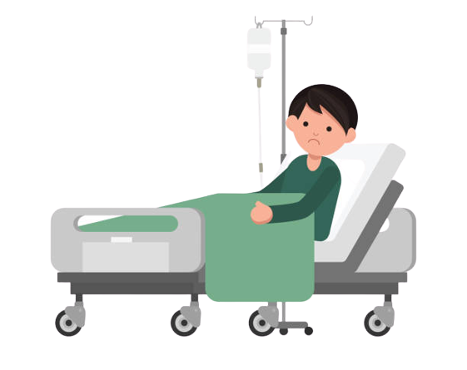






Current State | Illness-based Model
Tertiary Prevention
Crisis Pathway
50,000 Hospitalizations in 2016 ⁽¹⁾
Call 911/988
Taken to ER
Inpatient Care
Emergency Services
Emphasis on Symptom Reduction
Referral to Outpatient Care
3.2% of adolescents [6-17] taking antidepressants ⁽²⁾
Reactive Pathway
Scheduled Session & Initial Patient Assessment
“Long wait times”
Antidepressant Prescription
Understand Insurance Coverage for Mental Health Therapy
Search & Identify
Therapy Options
“Often limited”
Source:
(1) National Survey of Children’s Health (2016)
(2) Centers for Disease Control & Prevention (CDC)
© Copyright 2023 by Panos Efsta
All Rights Reserved

Slide 3




Solution | Dawn Health Wellness System
Biweekly Evidence-Based Assessments completed – separately – by both the child and their parent/guardian
Continuous Data Assessment & Translation to Care Pathways
- Addressing symptoms before they reach a crisis level
System-Prompt Pre-Crisis Intervention with Health Coaching Follow-ups
&
Therapy Counseling with Health Coaching Follow-ups
Parent development through
Coping Skills & Peer Community
© Copyright 2023 by Panos Efsta
All Rights Reserved

Slide 4







Solution | Wellness-based Model Workflow
Secondary Prevention
Tertiary Prevention
Pre-Crisis Pathway
Video
Intervention
Biweekly
Evidence-Based Assessments
System
Notification
Care
Navigation
Virtual Care
Therapy Session
Primary Prevention
Coping Skills
Development
24 & 48 hr.
Follow-up
Biweekly
Evidence-Based Assessments
Health
Coaching
Metabolic Health Coaching
Emphasis on Mental Health Resilience
© Copyright 2023 by Panos Efsta
All Rights Reserved

Slide 5

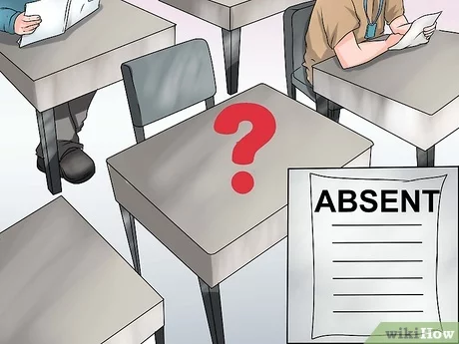
Solution | Measuring Success
Effectiveness of Care (Parent & Child Reported Data)
Academic Engagement
Days of School Missed
Patient Experience
Admissions to ER/Inpatient Care
Timeliness to Care
© Copyright 2023 by Panos Efsta
All Rights Reserved

Slide 6


